Slide 1
Probabilistic Modeling and Nested Inference
Jules Zisser
Advisors: Prof. Gera Weiss

Slide 2
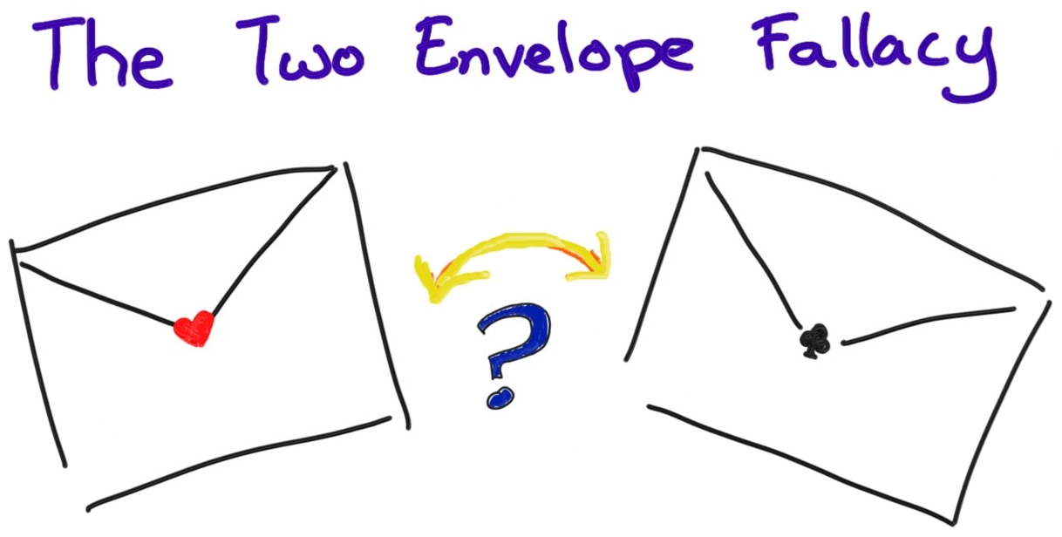

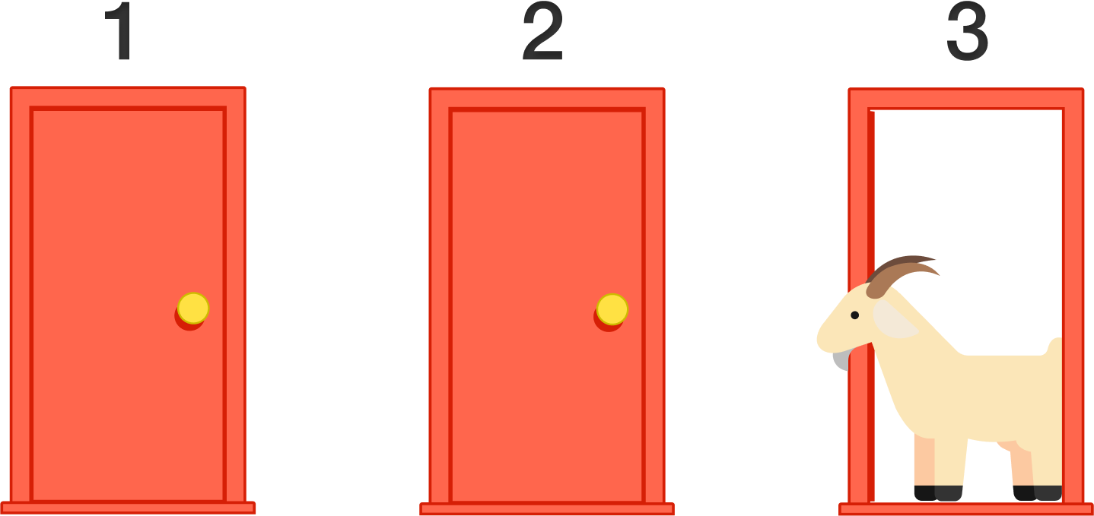
Motivation
People often make mistakes about probabilistic problems.
Notes:
The initial motivation
Doesn’t matter hard they are, or how smart the people - Solutions are non-trivial
Probability can contradict our common conception of how things work
Boy or girl “paradox”, monty hall, two envelopes

Slide 3
Proposed Solution
Use an intuitive way to describe probabilistic problems in order to model them.
Scenario-based specification of must/may/may-not occur and probabilities.
The program utilises probabilistic programming to infer the answer given the model.
Notes:
תרחישים / תסריט

Slide 4


Typical Model Trade-off
Generic catch-all model
Easy to use
Easy to use incorrectly
Requires lots of data
Specialized model
Less data required
Versatile use
Difficult and time consuming

Slide 5
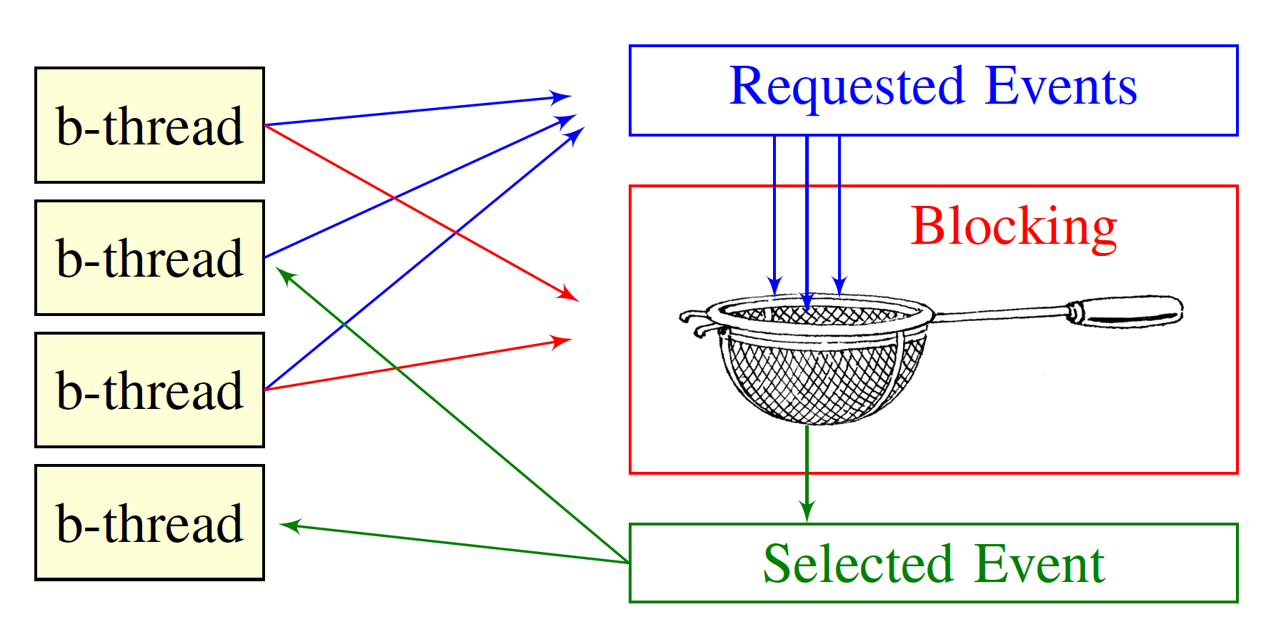
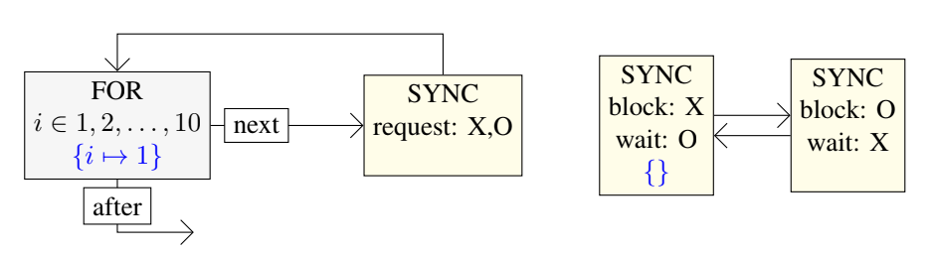
Method - Behavioral Programming
Multiple threads to describe the scenario.
Each one acts like an automaton, with special sync nodes to communicate between threads.

Slide 6
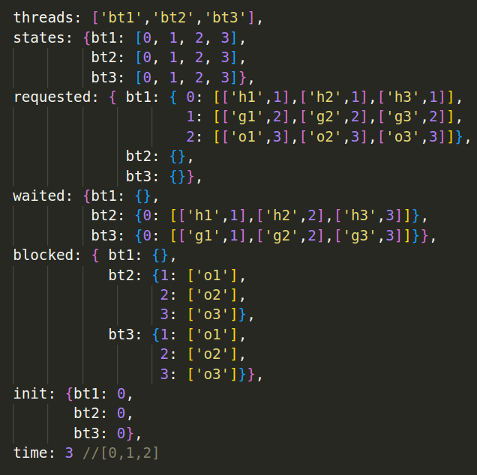
Problem Example - Monty Hall
Setup
Guess
Open
3 doors, hiding a prize and 2 goats
Guest picks a random door
Host opens a different one, revealing a goat
req: hide_1
hide_2
hide_3
req:
guess_1
guess_2
guess_3
req:
open_1
open_2
open_3
wait: hide_1
hide_2
hide_3
block:
open_1
block:
open_2
block:
open_3
hide_1
hide_2
hide_3
wait: guess_1
guess_2
guess_3
block:
open_1
block:
open_2
block:
open_3
guess_1
guess_2
guess_3

Slide 7
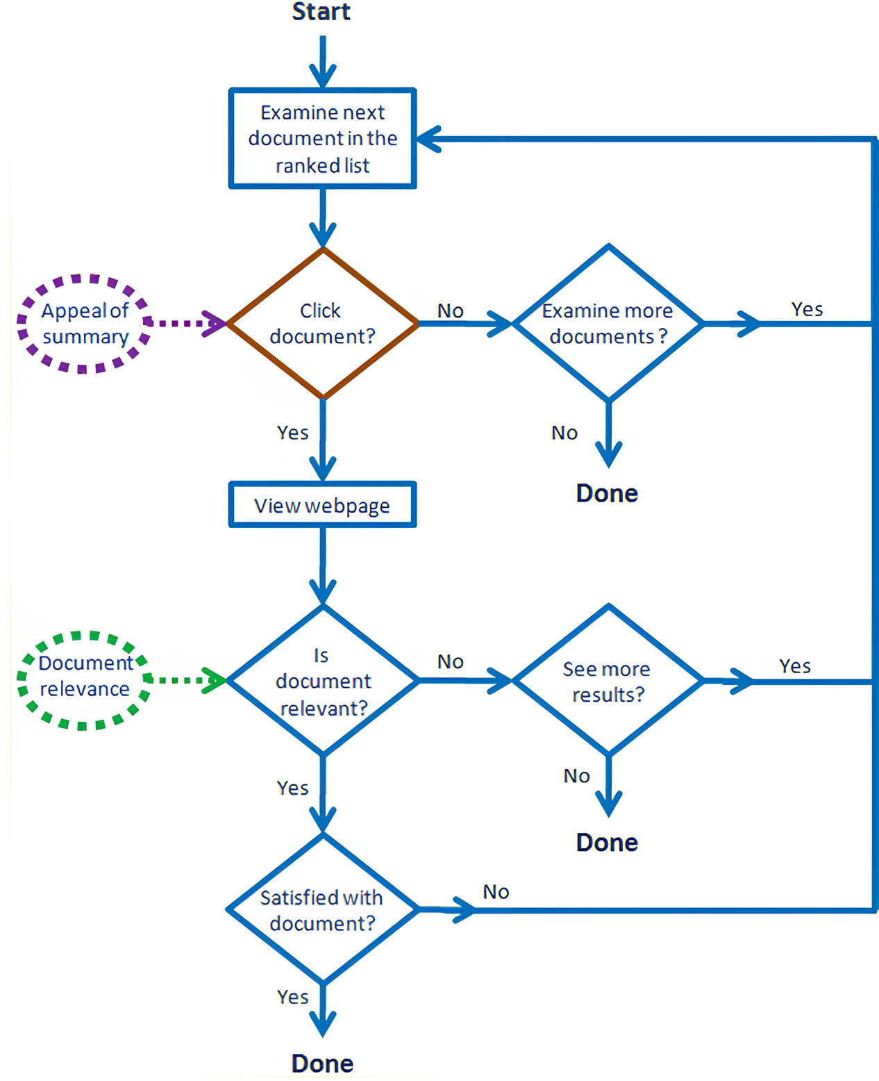
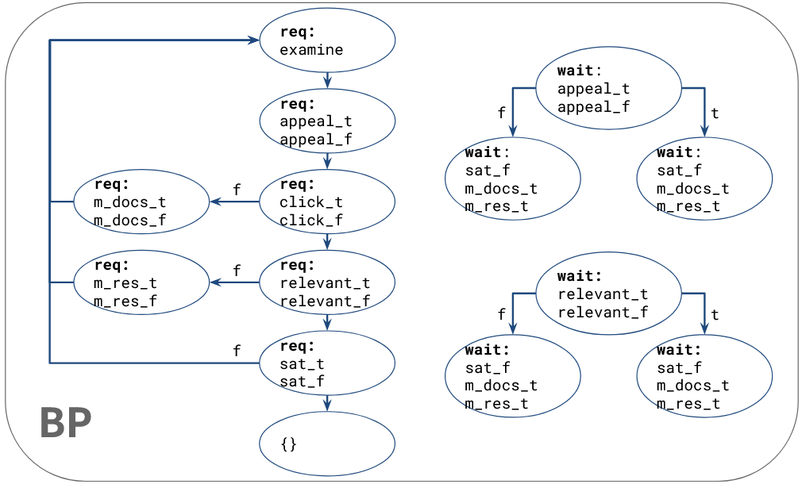
Problem Example - Page Click-through
Notes:
דוגמה נוספת להכללה של הרעיון: תוכנית בה אנחנו רוצים לקבל הסתברויות עבור פרמטרים לאו דווקא ידועים מראש

Slide 8
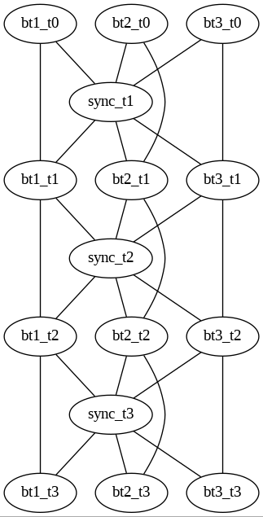
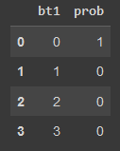
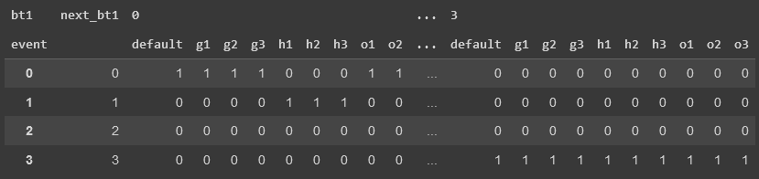
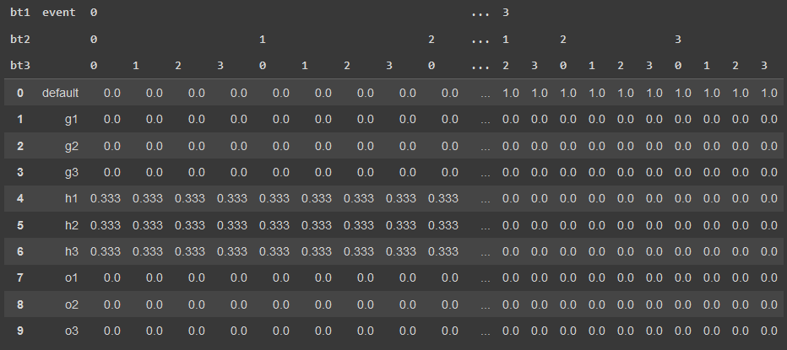
Previous Attempt by Or Kiraly
Model the state of each b-thread and the chosen event as random variable
Use this Bayesian Network (BN) structure to formalize the connections between the variables
Python implementation updated to now work with any script
Notes:
הבעיה העיקרית היא בקנה המידה - כל משתנה מקרי של sync הוא טבלה בגודל מספר האירועים, כפול מספר threads, כפול מצבים בכל thread
אנחנו רוצים להיות מסוגלים לבנות מודל יותר מותאם לבעיה, במקום תרגום כללי

Slide 9
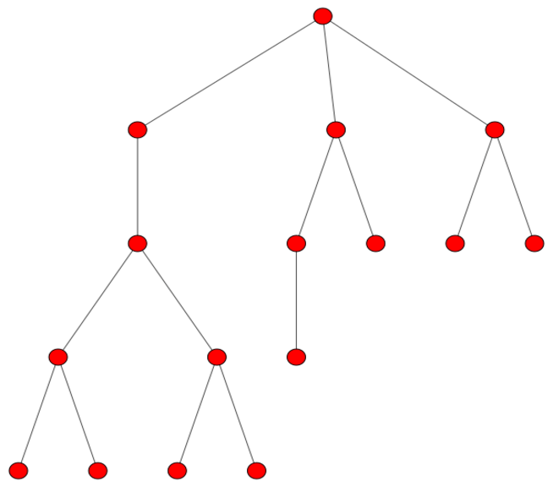
Nested Inference
Explores the network to assign probabilities to each event at a given step.
Start at initial state
Collect possible events from the current thread states
Choose one as having occurred and update each thread accordingly
Repeat until there are no more requested events
Implemented in WebPPL which is a JavaScript library for probabilistic programming.
The calculation can be done either analytically or by random sampling.
Limited to only the possible events as opposed to pre-calculating everything.
Notes:
Probabilistic programming allows us to condition the model on certain events

Slide 10
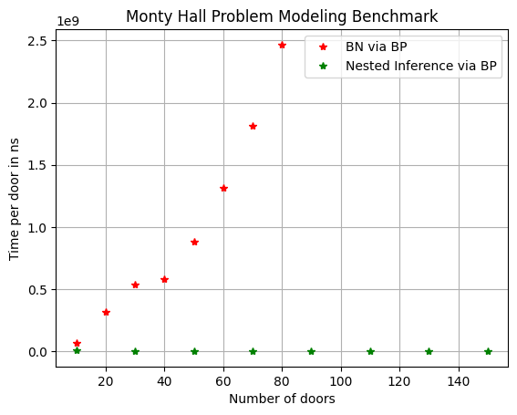
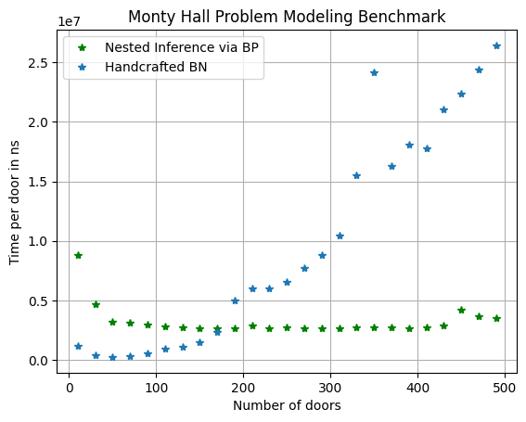
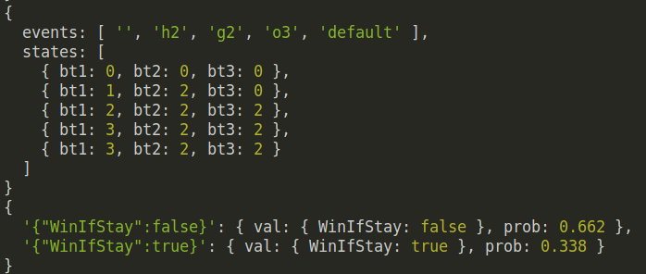
Results
Intuitive and fast to use program which can answer probabilistic questions, in addition to scaling well for large number of states.

